Slide 1
Monster Design
Time to taste Blueprint

Slide 2
Session 2 11-12,30 Goals
Introduce Perception
Setting up Behaviour Tree 101
Chasing the player
The following slides will go hand in hand with using the project on Blackboard.
Please download and open that project “MonsterAI.zip”, you have 5 minutes.

Slide 3
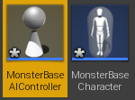
Create the classes
Create a folder in the Content Browser called “Student”
Create 2 blueprints;
A) one based off AI Controller called MonsterBaseAIController
B) one based off Character called MonsterBaseCharacter
Open them both.

Slide 4
MonsterBaseCharacter
We have 2 types of characters we can setup for todays session;
Spider
Troll
We need to setup the Character blueprint to use the various meshes and animations.
To do this lets edit some components in MonsterBaseCharacter.

Slide 5
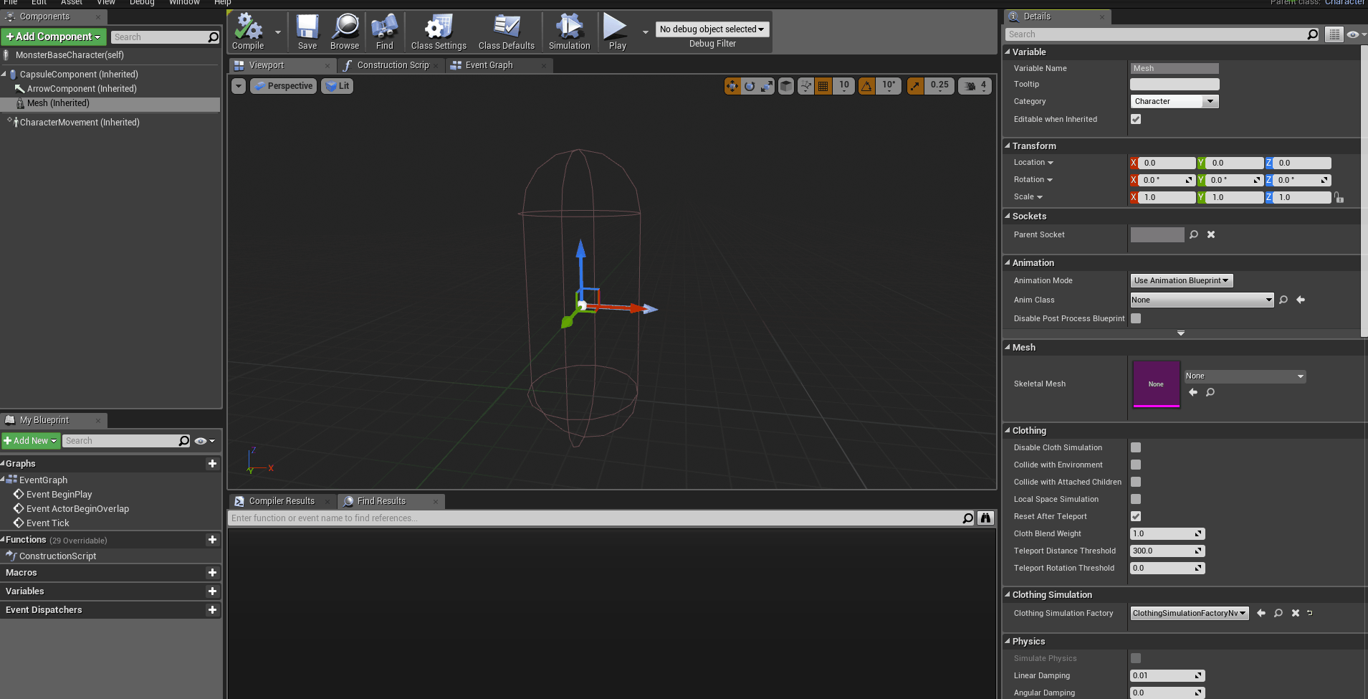
MonsterBaseCharacter
Setup the Mesh and Animation Blueprint as shown to the right.
You may use the Spider assets, but this presentation will focus on the troll.

Slide 6
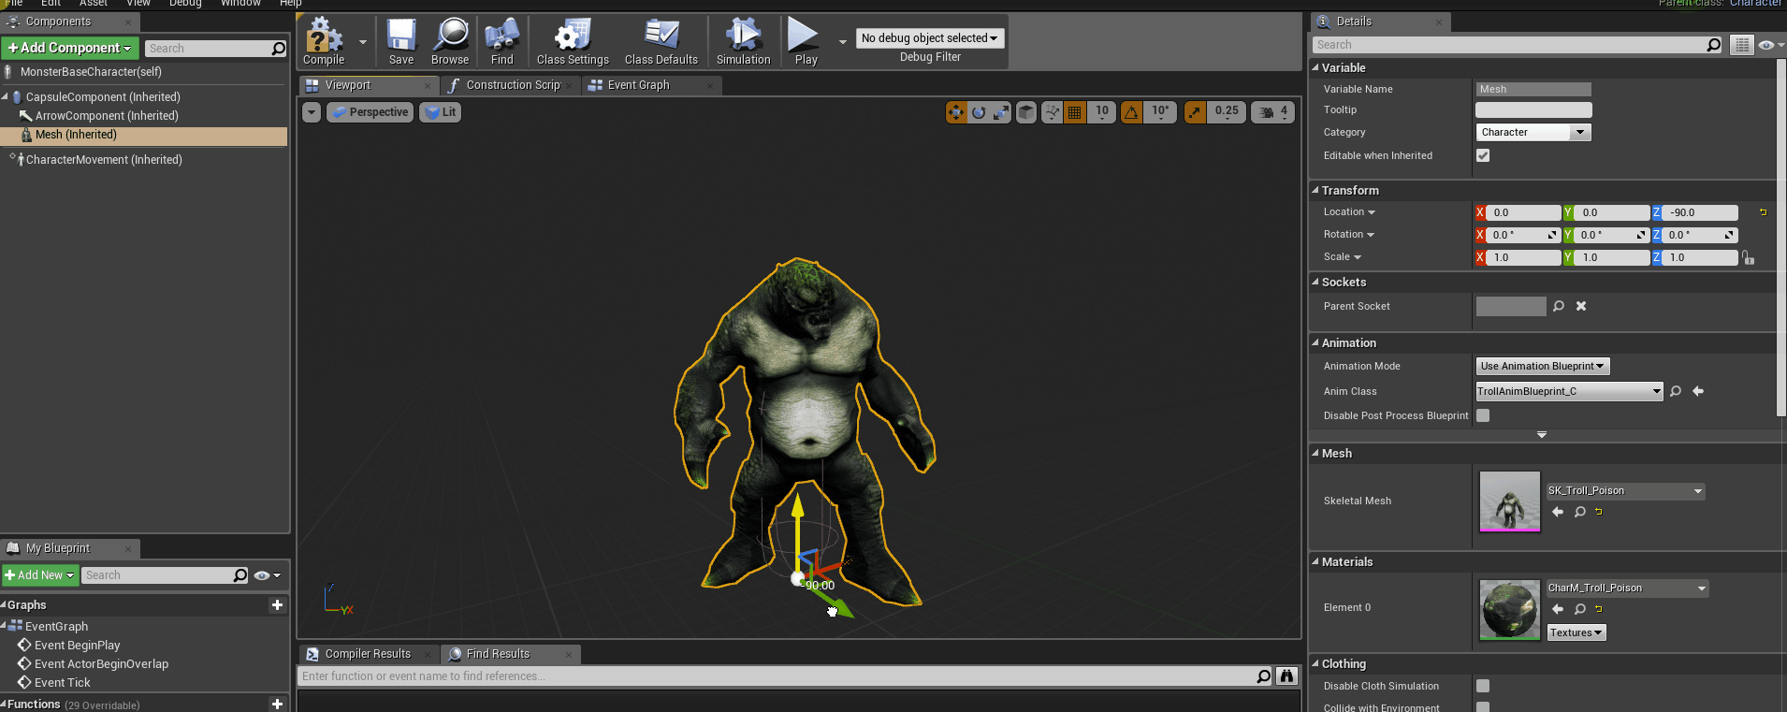
MonsterBaseCharacter
Next lets fix the collision so that it overlaps the player properly.

Slide 7
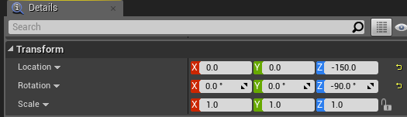
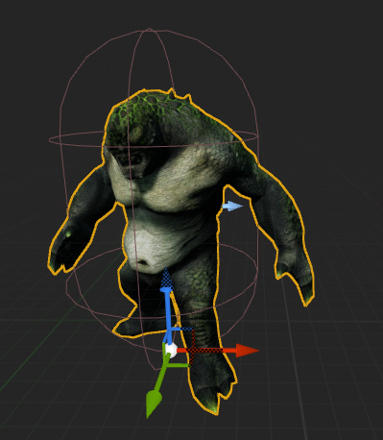
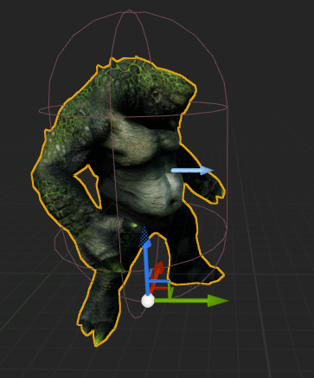
MonsterBaseCharacter
Make sure that the Mesh Component faces the same direction as the collision.
Rotate the Mesh Component on the Z Axis -90 degrees.
If you don’t do this the AI will walk sideways like a crab.

Slide 8
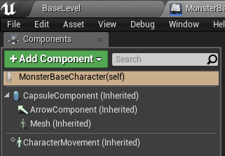
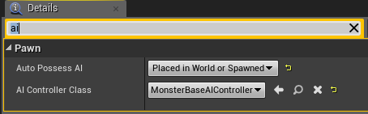
MonsterBaseCharacter
Now select the MonsterBaseCharacter route / self.
Search the details panel for AI and set the Auto Posses to Placed in World of Spawned and also set the AI Controller Class to MonsterBaseAIController.
If you do not do these steps Unreal will not assign our custom AI to the character and the AI may not posses the character properly (depends how you spawn).

Slide 9
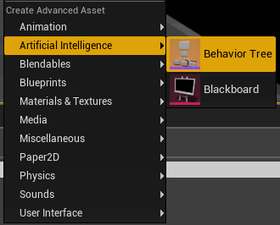
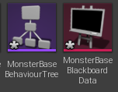
BaseBehaviourTree & Blackboard Data
Now create 2 more objects using the Content Browser.
A Behaviour Tree :- MonsterBaseBehaviourTree
A Blackboard :- MonsterBaseBlackboardData

Slide 10
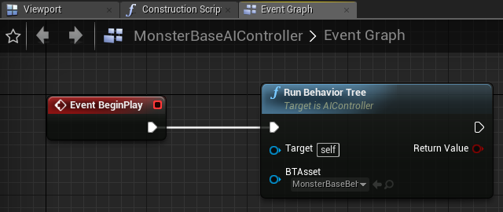
MonsterBaseAIController
In the MonsterBaseAIController we are going to start the Behaviour Tree.
To do so right click in the event graph and create a note called Run Behaviour Tree. The BTAsset needs to reference the Behaviour Tree we created via the content browser.

Slide 11
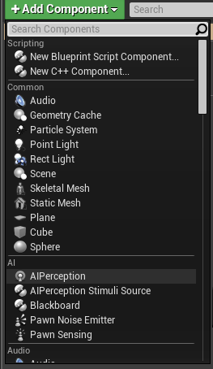
The Perception Component
To help us control the detection part of the AI, we will be utilising a perception component in the MonsterBaseCharacter.
You can add this by using the Add Component options in the MonsterBaseCharacter blueprint.
The perception component affords us a lot of functionality, in your own projects you may wish to utilise your own math instead of this component. Why? Well not all engines will have a premade component so it’s vital to learn the manual approach as well (see the notes for an example).

Slide 12
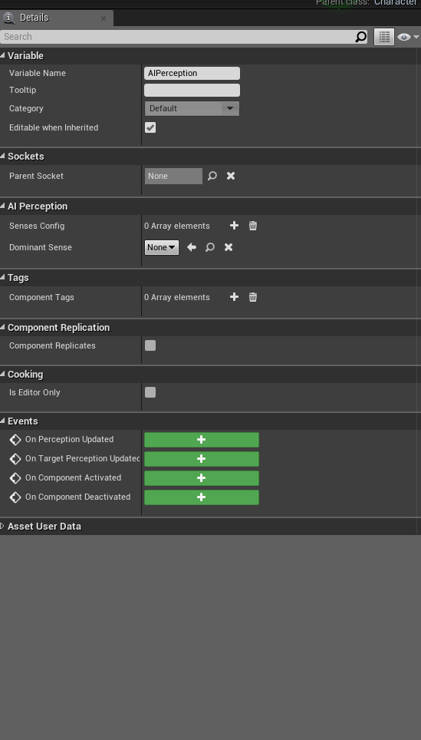
The Perception Component
With the Perception Component selected, I add in a couple of Senses to the Senses Config array shown to the right.
This array holds the Senses that the AI has.
Make sure to turn on all of the Detection Affiliations, or the component may fail to detect the player. These can be customised in a more complex project to align enemies with teams etc.

Slide 13
The Perception Component
Before delving much further into the settings of the Perception Component I would recommend utilising the AI Debug tools at this stage to give you an idea of what the values mean.
To use the AI Debug tools press the “@” key.
A debugger menu will appear, to see what the perception component does ensure to have NUM LK enabled and press 4.

Slide 14
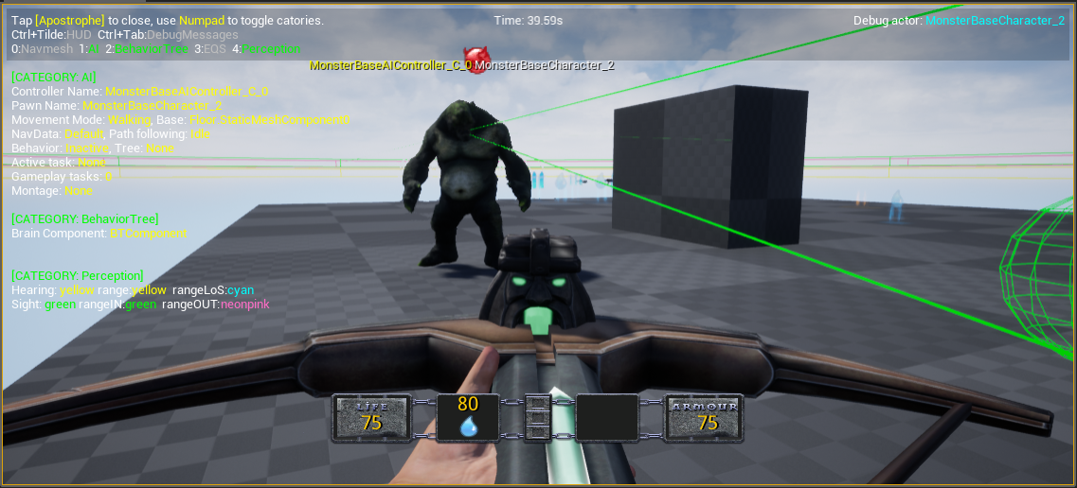
The Perception Component
The Debug tools work based on the direction you point in, so if there are multiple AI’s in the world it will target the nearest to your vision.
In this mode you’ll see the radius and FOV generated by the Perception Component.

Slide 15
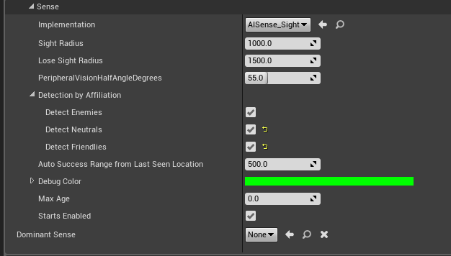
The Perception Component
The values entered into the Senses are your first opportunity as a designer to create an AI that reacts interestingly.
There are no magic answers for these values, happy testing.
Auto Success is defaulted to -1, if it stays at that value as soon as the AI looses sight / detection of the player it’ll stop registering. If you have a slight value here the AI will try to chase you if you are still close. This prevents Scooby Doo Villain moments.

Slide 16
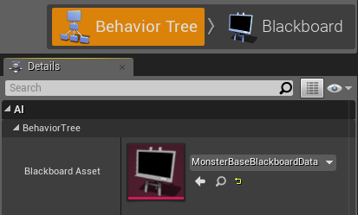
Setting up your first Behaviour Tree
Open up the Behaviour Tree we made earlier.
Using the Details Panel set the Blackboard Asset to MonsterBaseBlackboardData.
This will link the base variables to the AI.

Slide 17
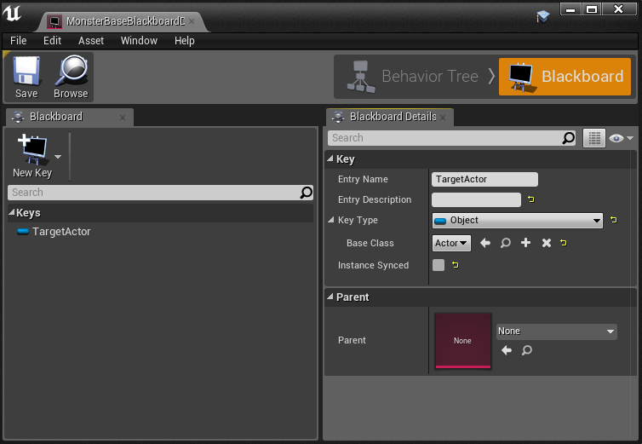
Setting up your first Behaviour Tree
Create a New Key in the Blackboard.
Name the key TargetActor
Set it’s Key Type to Object and it’s Base Class to Actor.

Slide 18
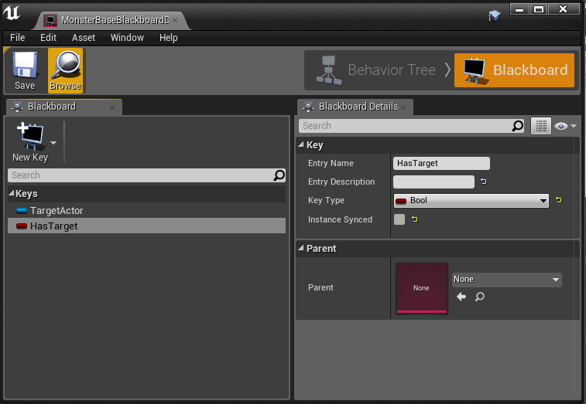
Setting up your first Behaviour Tree
Create a 2nd New Key. Name it HasTarget
Make it’s Key Type a Bool.
We shall use this track whether or not the AI can see the player.

Slide 19
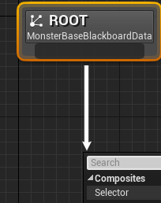
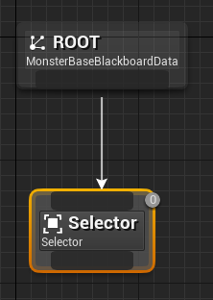
Setting up your first Behaviour Tree
Now we can start creating the tree. In the Behaviour Tree graph drag out from the bottom on the Root node.
Create a Selector node from the composites options.
The Selector node will choose between nodes lower down in the graph.

Slide 20
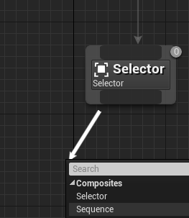
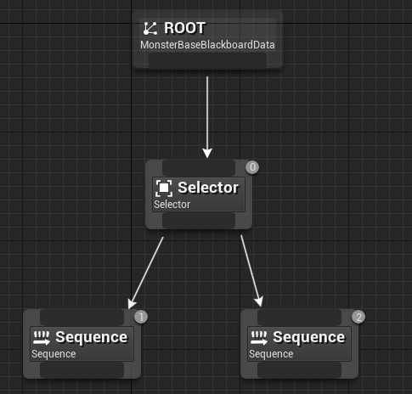
Setting up your first Behaviour Tree
Drag out twice from the Select node and create to Sequence Nodes.
The sequences will complete a series of notes in order. In this case we will use them to idle / chase the player.

Slide 21
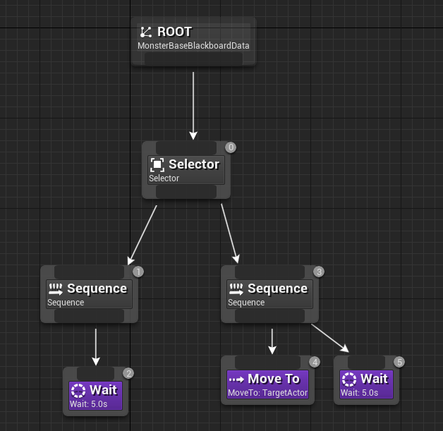
Setting up your first Behaviour Tree
To complete this section of the graph add in the purple Task nodes beneath the Sequence nodes.
We will customise the properties of these tasks in a moment.

Slide 22
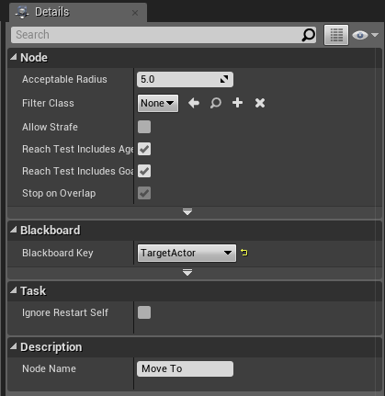
Setting up your first Behaviour Tree
Select the MoveTo Task Node and ensure that the Blackboard Key is set to TargetActor.
Customise / balance the Acceptable Radius value, this will control how far away the AI will stop from the Player.

Slide 23
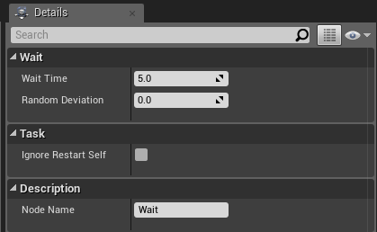
Setting up your first Behaviour Tree
The Wait Task nodes have only a few parameters.
The Wait Time value is in seconds, through play testing and planning you’ll get a better idea on the right kind of timing for pauses in AI behaviour.

Slide 24
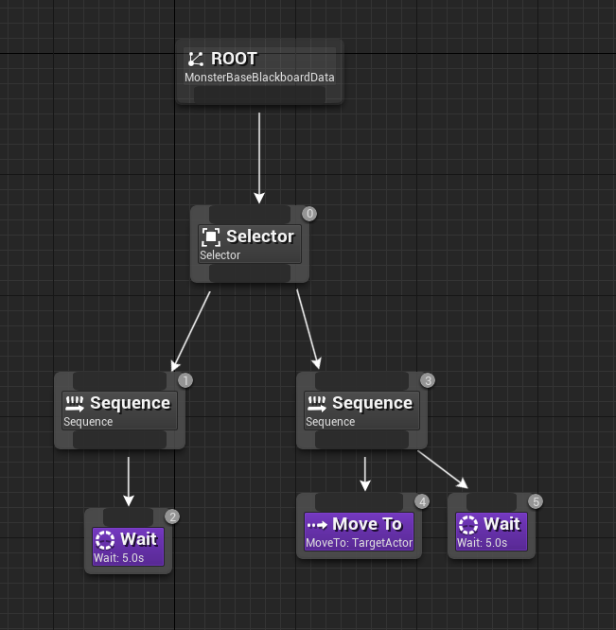
Setting up your first Behaviour Tree
With the tasks setup we are now left with a problem.
How does the Behaviour Tree decide which Sequence to select?
We are going to setup a simple way for now and then refactor later.
?

Slide 25
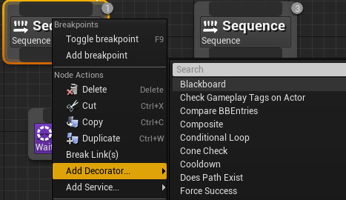
Setting up your first Behaviour Tree
Add a Blackboard Decorator to the Sequence nodes.
Blackboard Decorators allow us to check variables to break up logic.

Slide 26
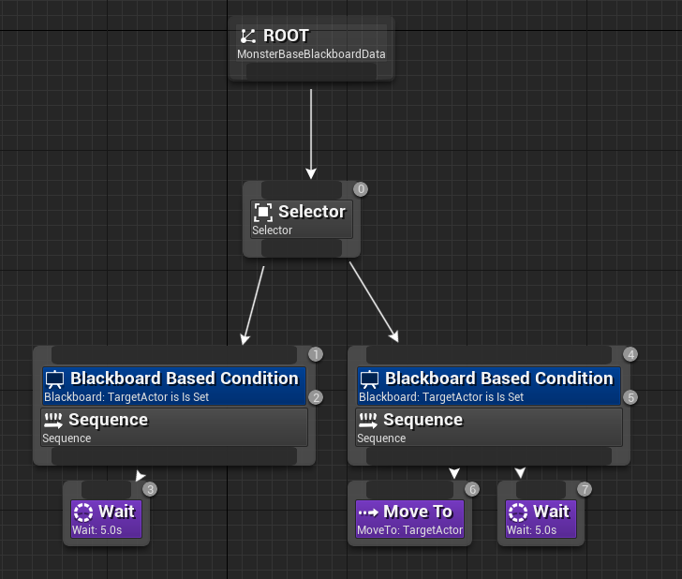
Setting up your first Behaviour Tree
With the Blackboard Decorators added the tree looks like this.
Now we need to setup the Details of the Decorators.

Slide 27
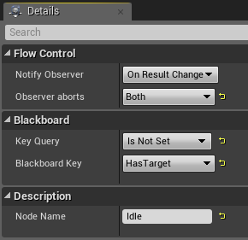
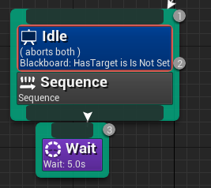
Setting up your first Behaviour Tree
On the left Sequence Node, I’ve renamed the Blackboard to Idle.
Set the Blackboard Key to “Has Target” and it’s Key Query to “Is Not Set”.
Finally Set the “Observer aborts” to both, this will cancel this branch of the tree if the Blackboard Key value changes.

Slide 28
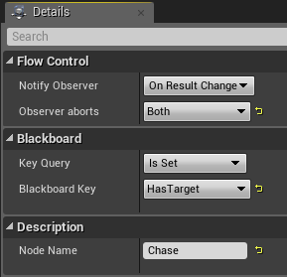
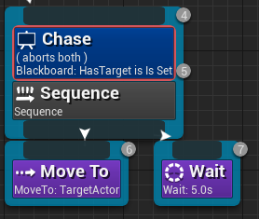
Setting up your first Behaviour Tree
On the right Sequence Node, I’ve renamed the Blackboard to Chase.
Set the Blackboard Key to “Has Target” and it’s Key Query to “Is Set”.

Slide 29
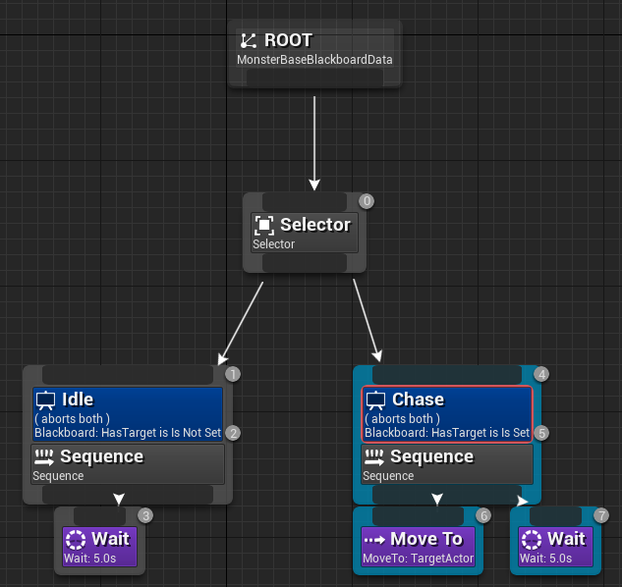
Setting up your first Behaviour Tree
The last problem to solve for this part of the graph is how to detect the Blackboard Key changes.
We are going to do this by adding a Service node to the Selector. This Service will be running on AI Tick when the branch of the tree is active. In this case it will be all the time as the Selector is always part of the tree. This is not optimal but it’ll do for now.
?

Slide 30
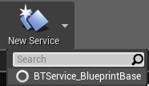

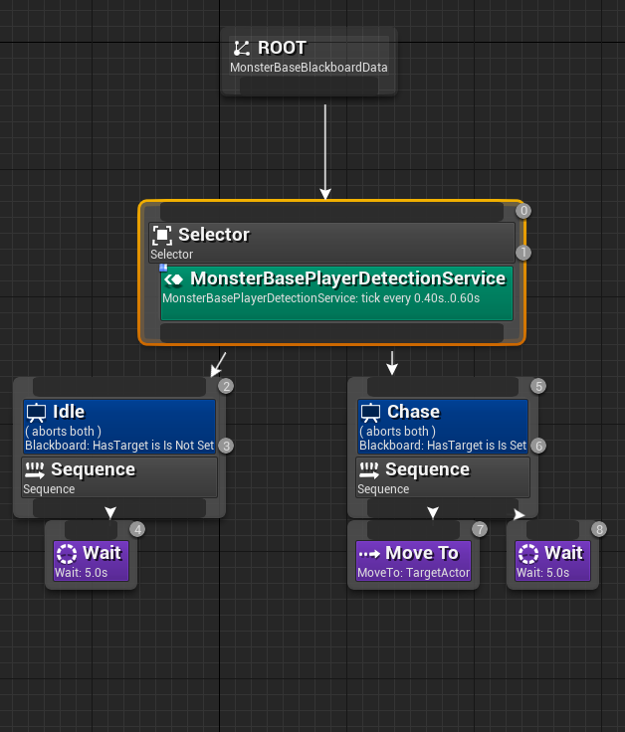
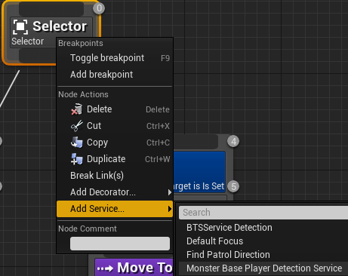
Setting up your first Behaviour Tree
Create New Service, I’ve renamed mine in the Content Browser to MonsterBasePlayerDetection.
Then right click on the Selector Node and add the Service.
It should appear as a green node below the Selector.

Slide 31
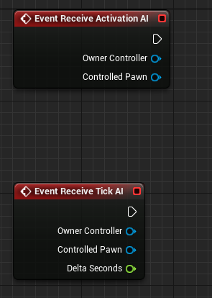
Setting up your first Behaviour Tree
Open the MonsterBasePlayerDetection Service and add in the two events.
Receive Activation is called when the Service first fires.
Receive Tick AI will occur constantly as the Service operates.

Slide 32
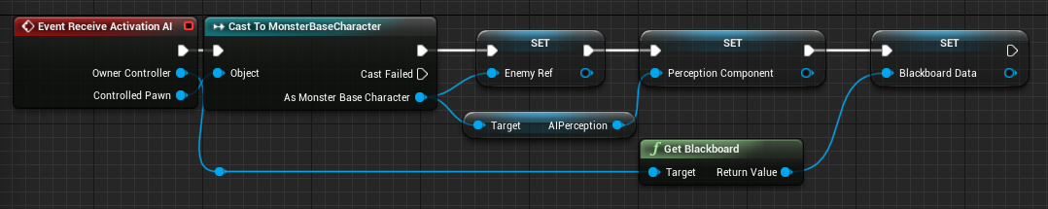
Setting up your first Behaviour Tree
Setup the following nodes for the Receive Activation AI node.
These will store references to the AI Character, AI Perception Component and AI Blackboard Data. These are stored as you don’t on Activation rather than on Tick as the variables will remain constant whilst the AI is alive.

Slide 33
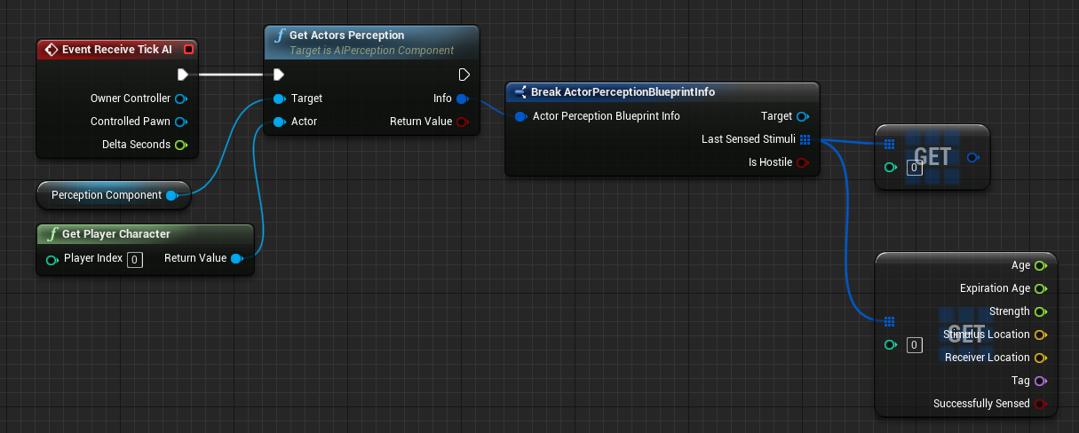
Setting up your first Behaviour Tree
Create the following nodes below connecting to the Receive Tick AI.
The nodes below check the Perception Component of the AI and access it’s Last Sensed Stimuli array. The 2 Get nodes, they are pretty much the same but the lower one has had it’s properties split to show all the variables in the structure.

Slide 34
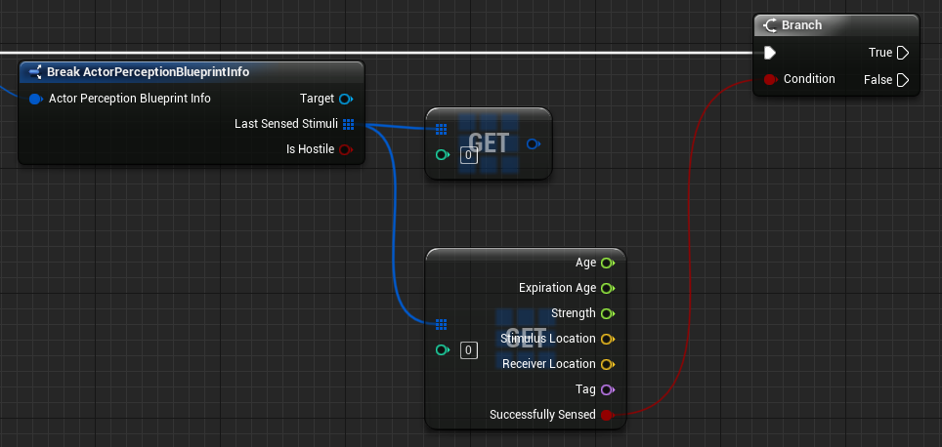
Setting up your first Behaviour Tree
Draw out from the Successfully Sense Bool and connect it into a Branch.

Slide 35
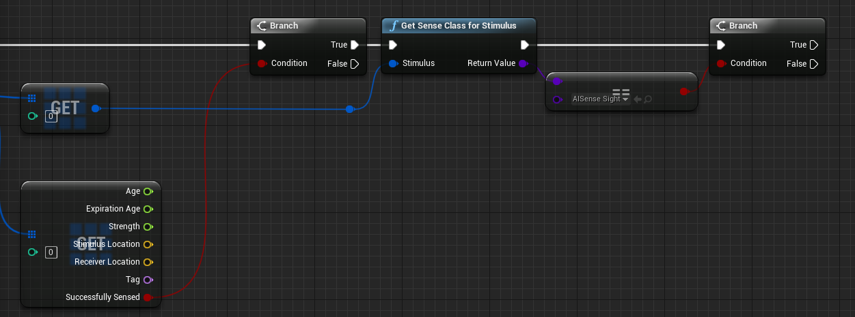
Setting up your first Behaviour Tree
Drag out from the upper Get node, create a node to Get the Sense Class and check that it’s an AISense_Sight. Finally connect this into a Branch.
The idea with these series of nodes is to act only when a successful sight change has occurred, this can be important as you might hook up 4/5 different senses.

Slide 36
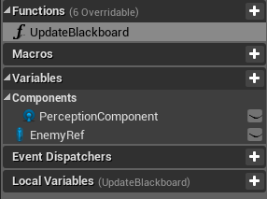
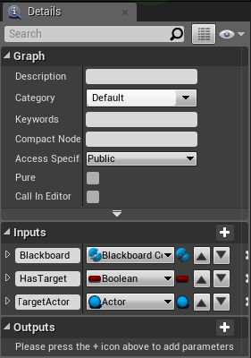
Setting up your first Behaviour Tree
Create a function in the Service called UpdateBlackboard.
Add 3 inputs to the service named;
Blackboard
HasTarget
TargetActor
This function exists to prevent writing out the same Blueprint 3 times, see the next slide.

Slide 37
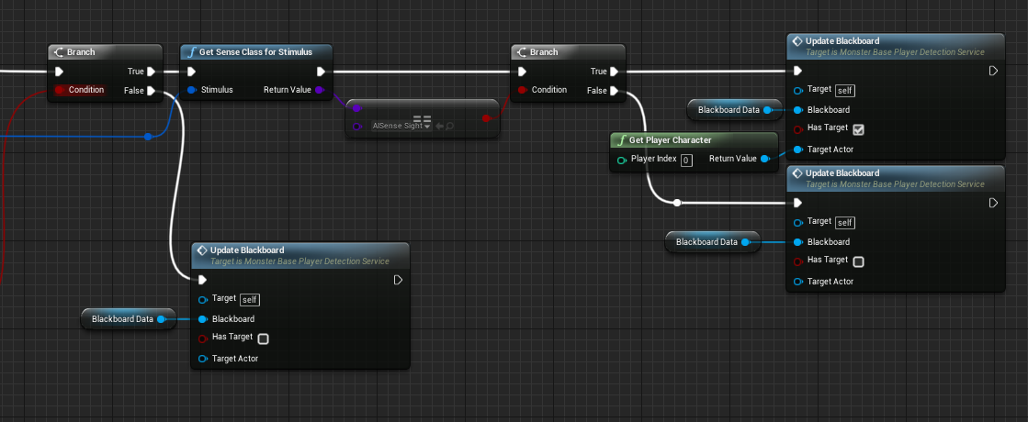
Setting up your first Behaviour Tree
Drag and drop the create functions into the main event graph and set the parameters as below.
The top most flow is a successfully sight detection of the player, where as the other runs of the function remove the Blackboard Keys and set the AI to idle.

Slide 38
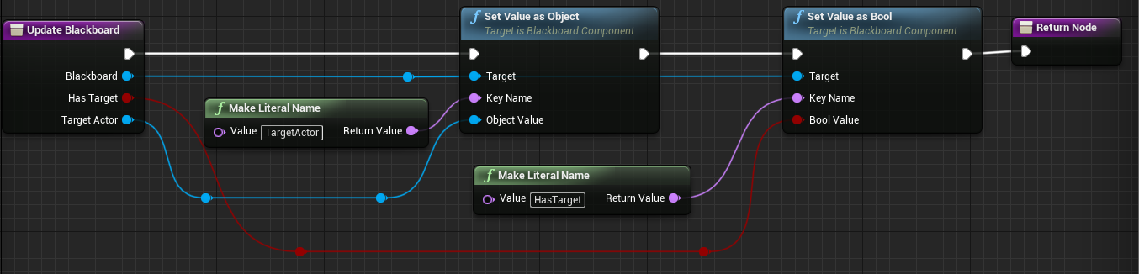
Setting up your first Behaviour Tree
With the function placed, open up the function and setup the following nodes. The UpdateBlackboard function sets the Blackboard Bools.
Be sure to place a return node at the end of the function.

Slide 39
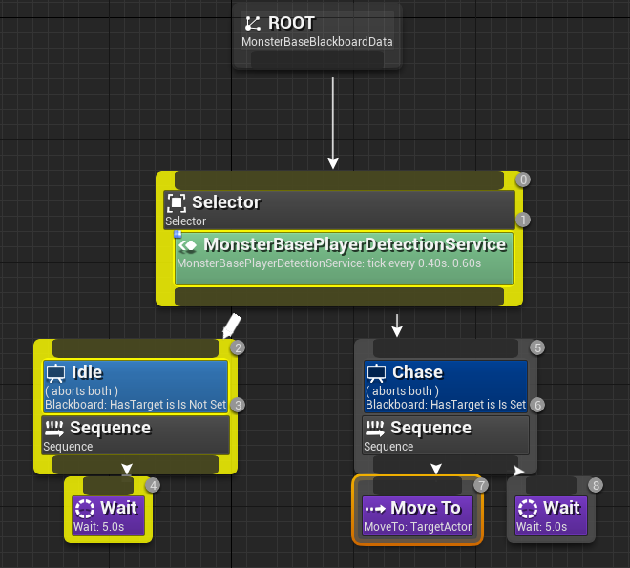
Setting up your first Behaviour Tree
When the game runs the Behaviour Tree should execute as follows when the AI cannot see the player.

Slide 40
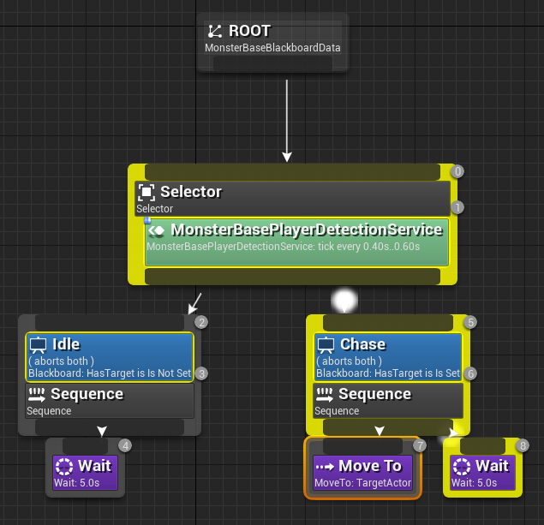
Setting up your first Behaviour Tree
As soon as the player is spotted the flow should swap over to the Chase Sequence.
You will probably find it quite easy to avoid the AI with large Wait pauses.

Slide 41
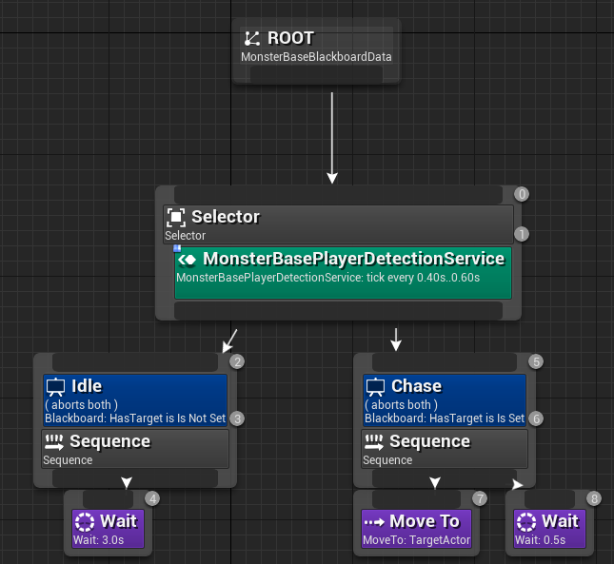
Tweaking the AI
I would lower these Wait cycles as shown on the bottom right.
I would make the Idle Wait fairly long but the MoveTo Wait can be quite short.
The shorter you make the second Wait the harder it’ll be to avoid the AI.

Slide 42
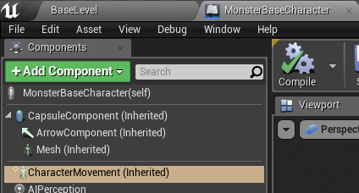
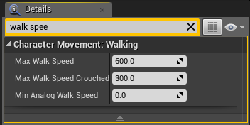
Tweaking the AI
Inside of the MonsterBaseCharacterBlueprint you can further customise the feel of the AI.
Select the CharacterMovement Component and alter the Walk Speed. The default is quite high for a lumbering troll, to a lower value.

Slide 43


Problems with approach
As mentioned previously this approach so far is a bit clumsy as it’s constantly checking an array on Tick. It works but at the start of the game the array will be empty so you’ll get some warnings.

Slide 44

Problems with approach
So if Tick is a problem how can you counter act it and build something a bit more intelligent?
Any ideas?

Slide 45


Setting up your first Behaviour Tree
A more optimal approach is to use the MonsterBaseCharacter, here you can use the AIPerception component to call an event “On Target Perception Updated”.
The Perception Update will occur at a far less frequency to that of the Tick Event.

Slide 46

Setting up your first Behaviour Tree
To use the MonsterBaseCharacter for Perception all I’ve done is replicated the service flow but without the functions. The same branches and Blackboard key nodes exist.
One important difference is that the node Event Begin Play is used in the character to store a reference to the Blackboard Data, instead of the Receive Activation AI in the Service.

Slide 47

Setting up your first Behaviour Tree
When utilising the MonsterBaseCharacter you don’t need to use the Service Node.
The Blackboard Keys are set in the Character and so we can delete the Selector Node.

Slide 48
Chill
Go and grab a drink / stretch your legs for a bit, when we come back we’ll look at audio detection.

